Slide 1

Dashboard Report Pack:
Scoping Presentation.
Presented By: Nadir Debbabi, Tracy Nguyen Cao, Kurt Minks, Glenn Davies, Vakishna Thayalan, & Tom Miller.

Slide 2

Agenda
Introduction To FeeSynergy
1.1 - FeeSynergy Business Overview
1.2 - FeeSynergy Features
1.3 - Architecture
1.4 - Business problem
1.5 - Presentation purpose
System Overview
2.1 - High Level System Architecture Diagram
2.2 - Use-Case Diagram
2.3 - Entity Relationship Diagram (ERD)
Project Implementation
3.1 - Product Comparison
3.2 - Comparison Table
3.3 - Dashboard UI Concept
3.3 - Report Concept
Software Demo
4.0 - Screen Shared - Software Demo & Discussion
Project Planning
5.1 - Work Breakdown Structure
5.2 - Gantt Chart
5.3 - Backlog Catalogue
Project Maturity
6.1 - Project Timeline
6.2 - Improvements
6.3 - Team Reflection
Conclusion
7.1 - Conclusion
Q&A / Feedback

Slide 3

1.0:
Introduction To FeeSynergy

Slide 4
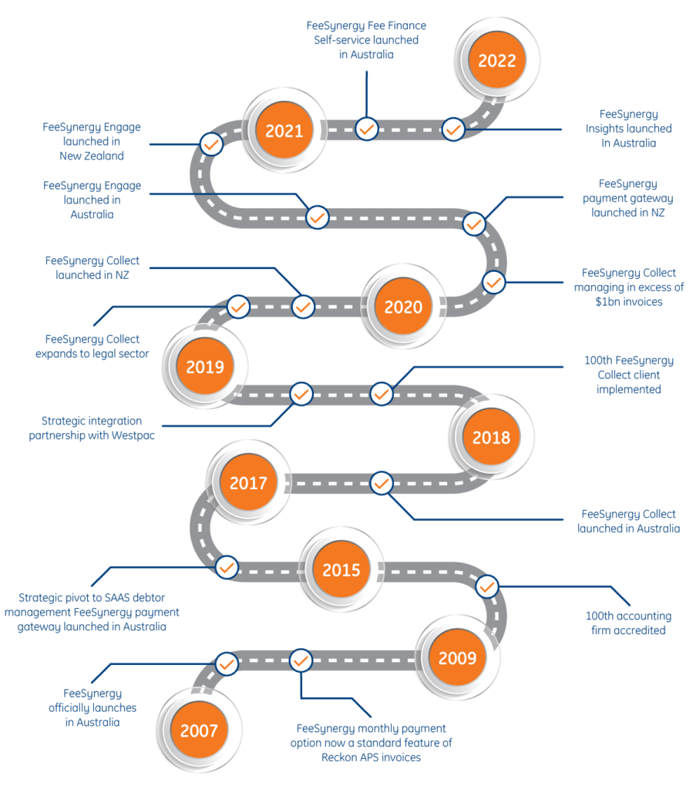
1.1
FeeSynergy Business Overview
Introduction to FeeSynergy:
FeeSynergy launched in Australia in 2007, as a professional fee financing service for accounting and legal firms.
In 2015 FeeSynergy found a market opportunity and developed their SaaS FeeSynergy Collect, a debtor management solution tailored for the accounting and legal industry 2019.
The FeeSynergy platform has integration with accounting and legal practice management software,such as MYOB, APS and LexisNexis to name a few.
In 2020 FeeSynergy was managing over $1billion in invoices.
In 2020 FeeSynergy expanded their services to New Zealand.

Slide 5
1.2
Features of FeeSynergy platform include:
Online payments with support for debit cards, credit cards and bank to bank transfers.
Direct debits from bank and credit card accounts.
Analytics, insights and reports for partners and managers through their dashboarding service, including Equifax credit scores and automated emails.
Self-servicing for invoice and statements, with seamless integration with practice management software.
An accounts receivable service for Feesynergy Collect customers, that manages and records all receivable operations, for the user.
Fee Finance service that is an independent product that's fully integrated with FeeSynergy Collect.
FeeSynergy Features

Slide 6
1.3
The FeeSynergy System Architecture consists of these main systems:
Credit Card Payment Gateway
Debtor Management System
Loan Management System
FeeSynergy System Architecture

Slide 7
1.4
FeeSynergy wants to monitor their KPIs:
Currently to monitor your KPI’s, data needs to be extracted from the systems and then compiled into reports and graphs.
This is a time consuming process that can take an analyst around 2 days to complete.
FeeSynergy would like to automate this process, using analytic and dashboarding software.
FeeSynergy would also like to take advantage of other advanced features that are possible with an improved automated process.
Business problem

Slide 8
1.5
Solving the business problem
We will demonstrate our current understanding of the business problem
And how key parts of the problem can be solved using technology through examples.
We are seeking feedback from FeeSynergy, on our current understanding of the business problem, and the examples shown.
We will also go over our current progress and timeline for the project.
Getting feedback from FeeSynergy will help us develop a solution, that best matches your needs.
Purpose of the presentation

Slide 9
2.0:
System Overview

Slide 10
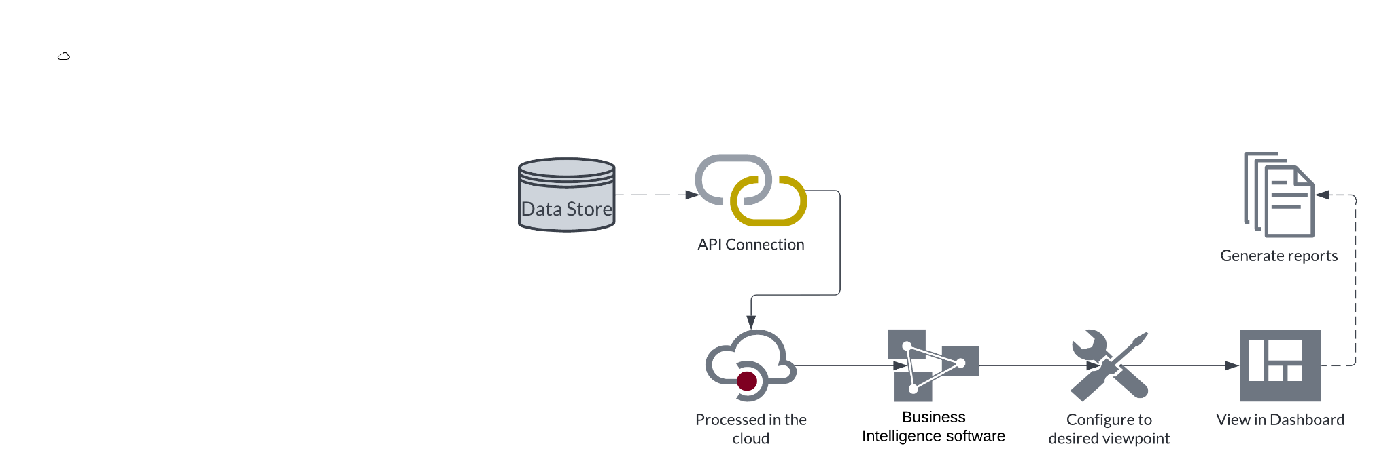
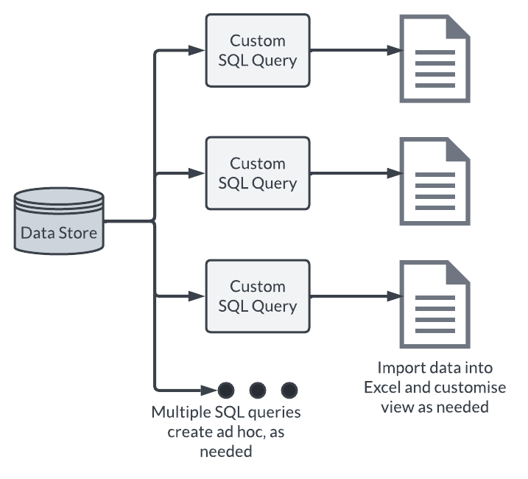
2.1
High Level System Architecture Diagram
Current System
Proposed System

Slide 11
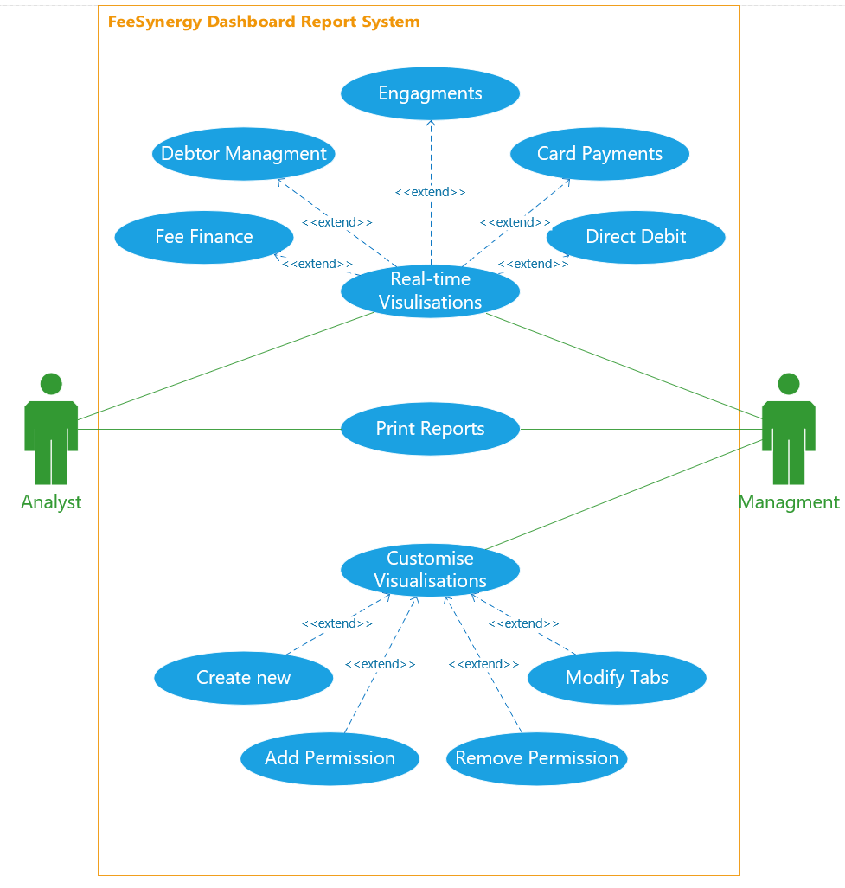
2.2
Use-Case Diagram

Slide 12
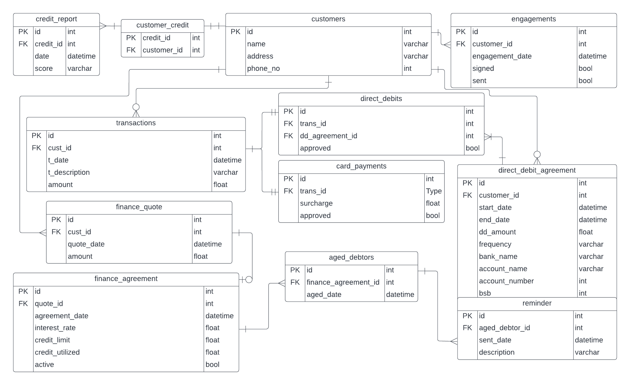
2.3
Entity Relationship Diagram (ERD)

Slide 13
3.0:
Product Comparison
Please switch to screen share.

Slide 14




3.1
Comparison
Tableau

Slide 15
3.2
FEATURES | Power BI Service | AWS QuickSight | Tableau
DATA SOURCE AND BROWSER INTEGRATION | Leading browsers on Desktop and Mobile. Integrates with Azure SQL,Oracle, Google. | Leading browsers on Desktop and Mobile. Integrates with AWS, SQL,Oracle, Google. | Leading browsers on Desktop and Mobile. Integrates with nearly all data sources.
REAL TIME DATA AND AVAILABILITY | Automated refresh schedule | Connection dependent | Real-time monitoring available, requires scripting
USER FRIENDLINESS AND INTUITIVENESS | User friendly with drag/drop capabilities | Easy to deploy with excellent visualisations | User friendly and highly intuitive
REPORT VIEWING FROM DASHBOARD | ✔ | ✔ | ✔
DASHBOARD DATASET FILTERING | Reports Only | ✔ | ✔
Comparison

Slide 16
3.2
FEATURES | Power BI Service | AWS QuickSight | Tableau
DASHBOARD TILE CUSTOMISATION | Highly Customisable | Highly customisable | Customisable, feature rich, complex.
MULTIPLE DASHBOARD CAPABILITY | Favourites | Tabs | Tabs
REPORT EXPORT FORMATS, PRINTING | CSV, PDF | CSV, XLSX | CSV, PDF
REPORT SHARING, SUBSCRIPTION AND SCHEDULES | Highly customisable, Microsoft integration | Customisable | Highly customisable
SECURITY AND ACCESS | Role based, Encrypted | Role Based, Encrypted | Role Based, Encrypted
SUPPORT | Online, and BHs | Online, and BHs | Premium 24/7 BHs /Extended for Weekend.
PRICING | $$ | $/$$ | $$$
Comparison,
cont.

Slide 17
3.3:
Dashboard UI Concept

Slide 18
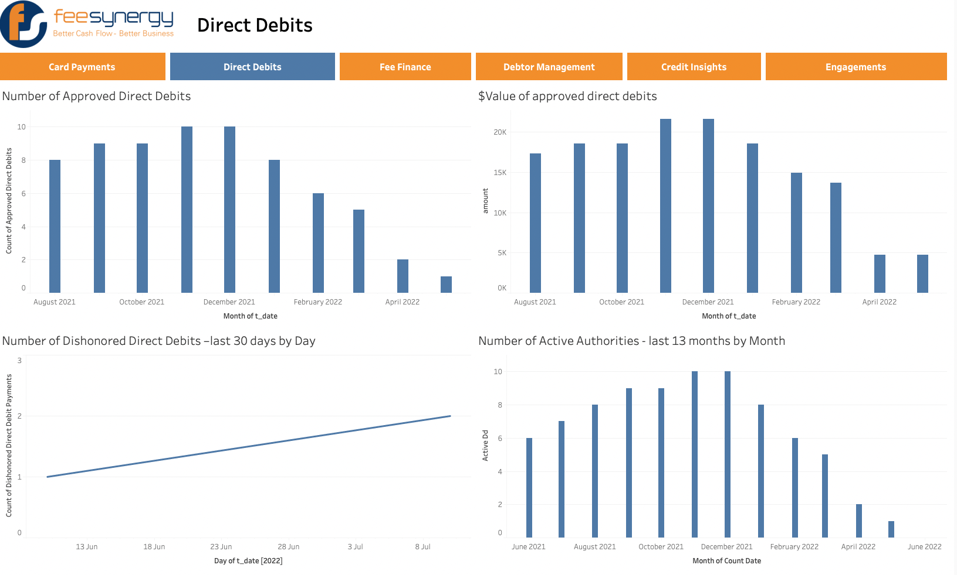
As a user I want a heading for the report so that I can easily differentiate with other reports
As a user I want the company logo and colour scheme so that it reflects the company’s brand

Slide 19
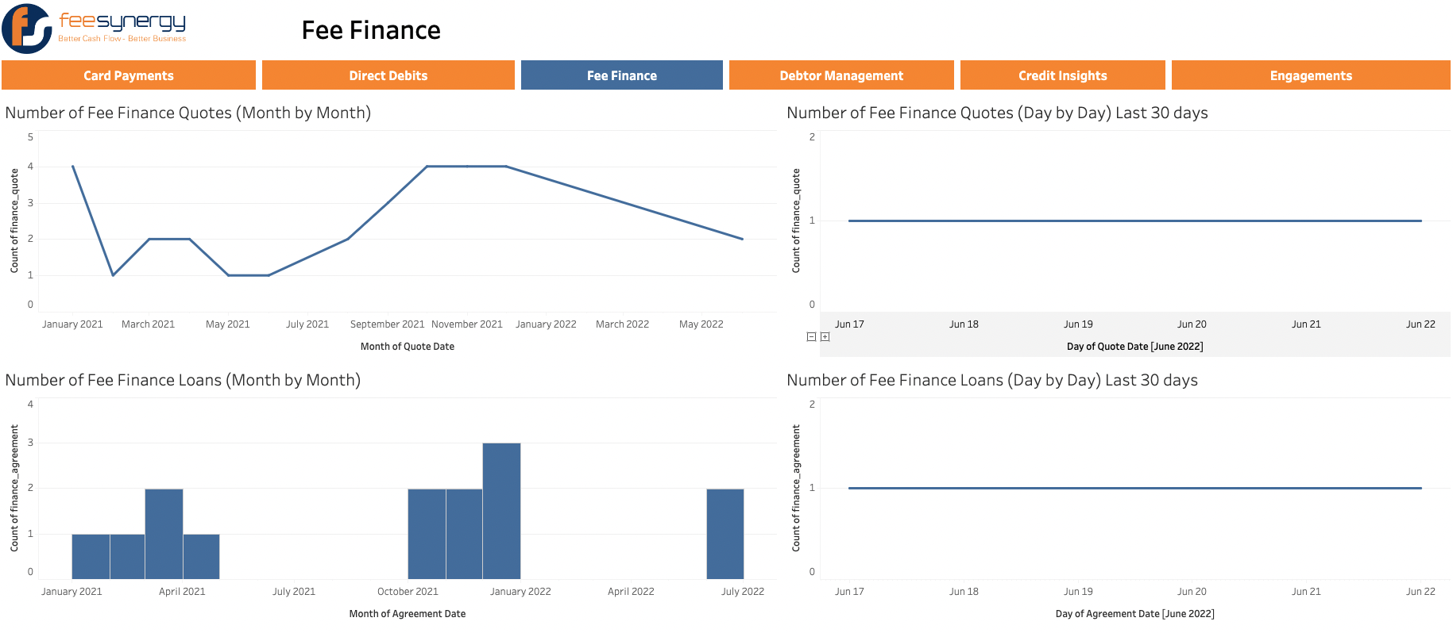
As a user I want to be able to navigate the visualizations so that I can quickly find the relevant visualizations among the different aspects of the business.
As a user I want to be able to view the visualizations in real time so that I can work with the most up to date data.

Slide 20
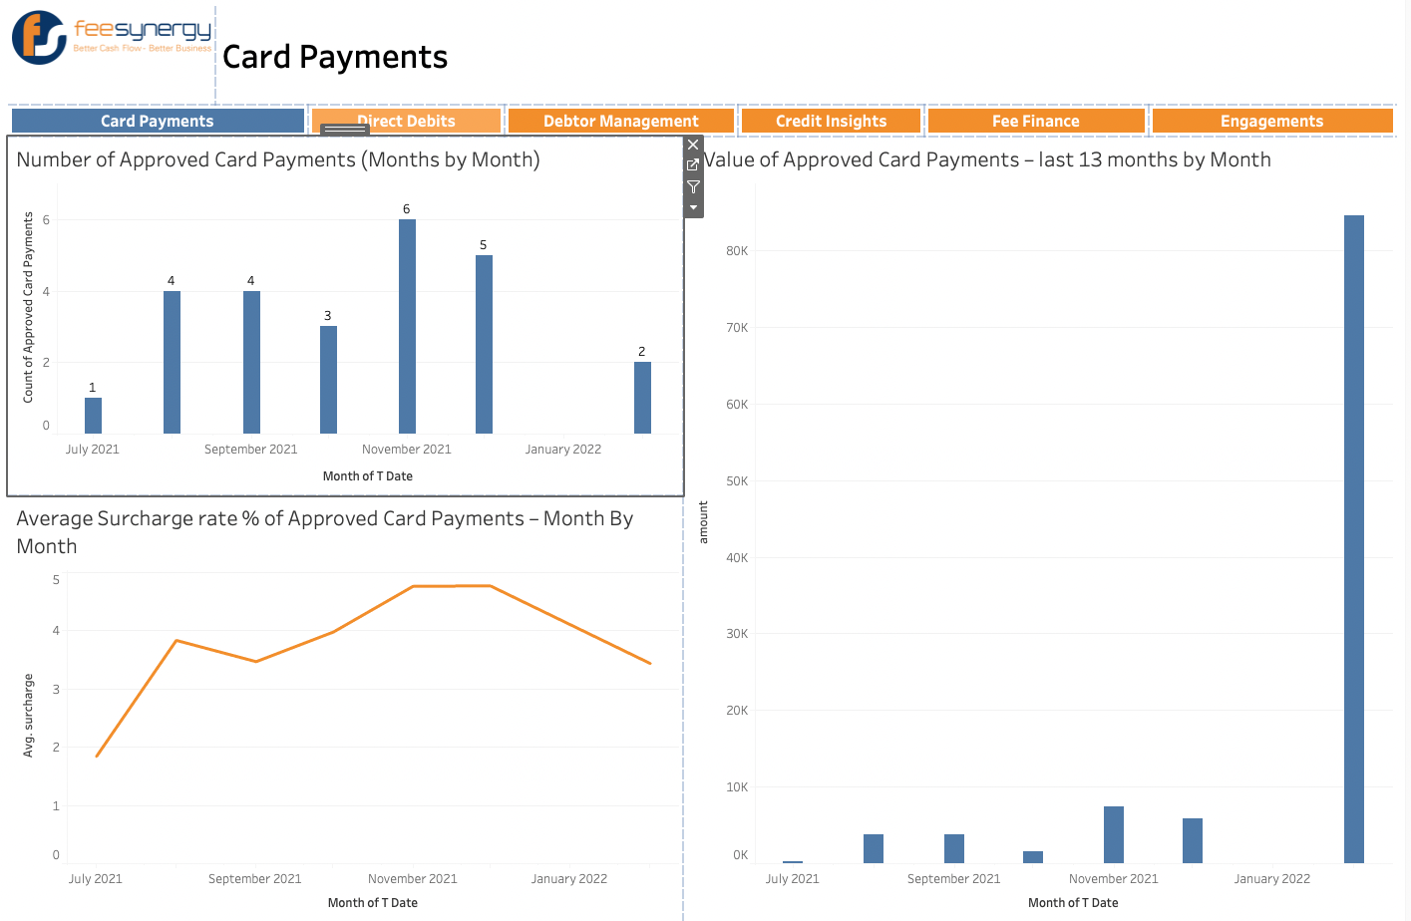
As a user I want to be able to filter through the data so that I can see the visualization appropriate to different conditions.
As a user I want to be able to customize the dashboard views so that I can interact with the relevant visualizations best suited to my preference.

Slide 21
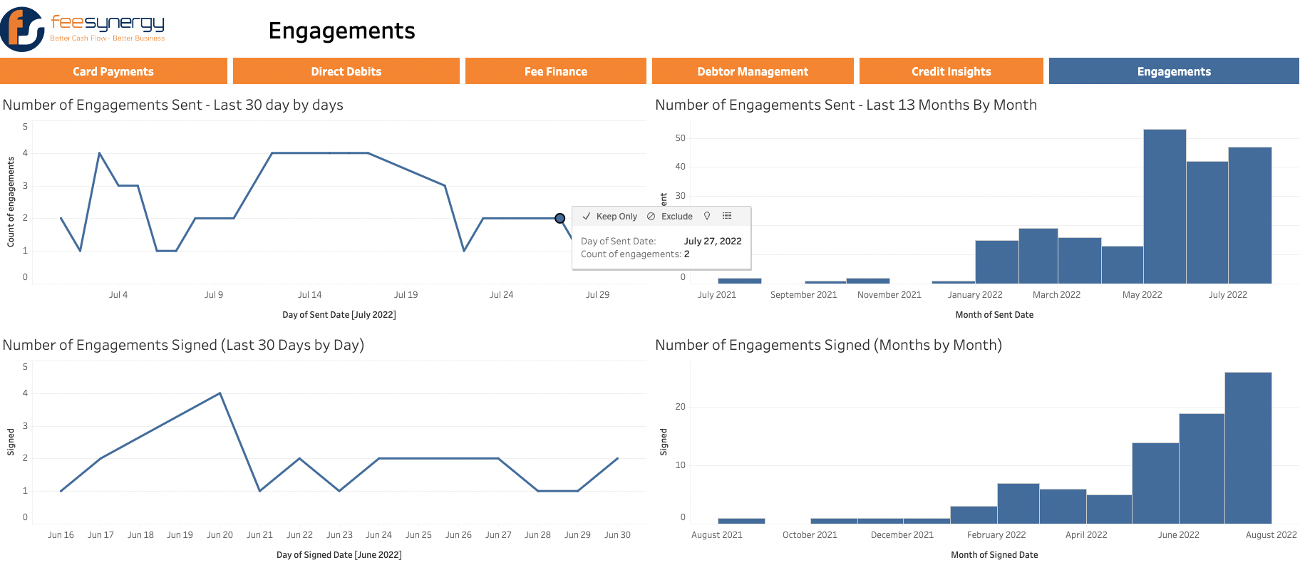
As a user I want to be able to interact with the charts so that I can easily interpret the data at different points.

Slide 22
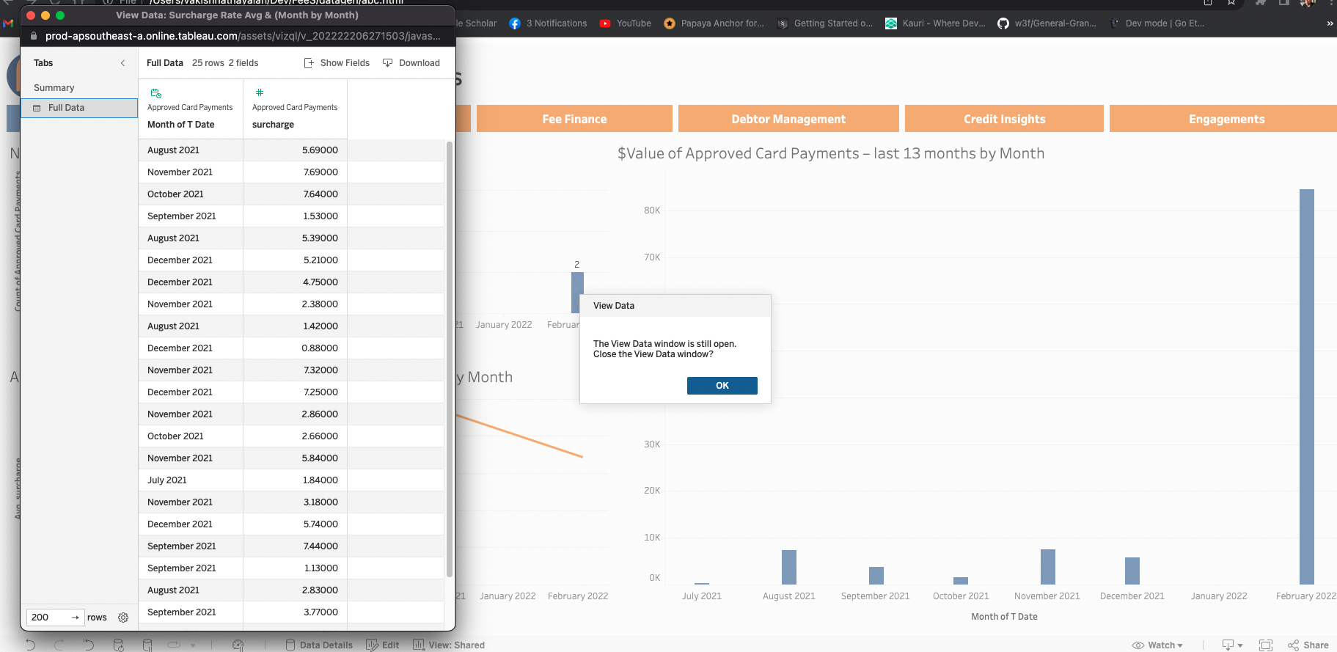
As a user I want to be able to see the data which makes up the visualizations so that I can verify the chart is accurate.

Slide 23
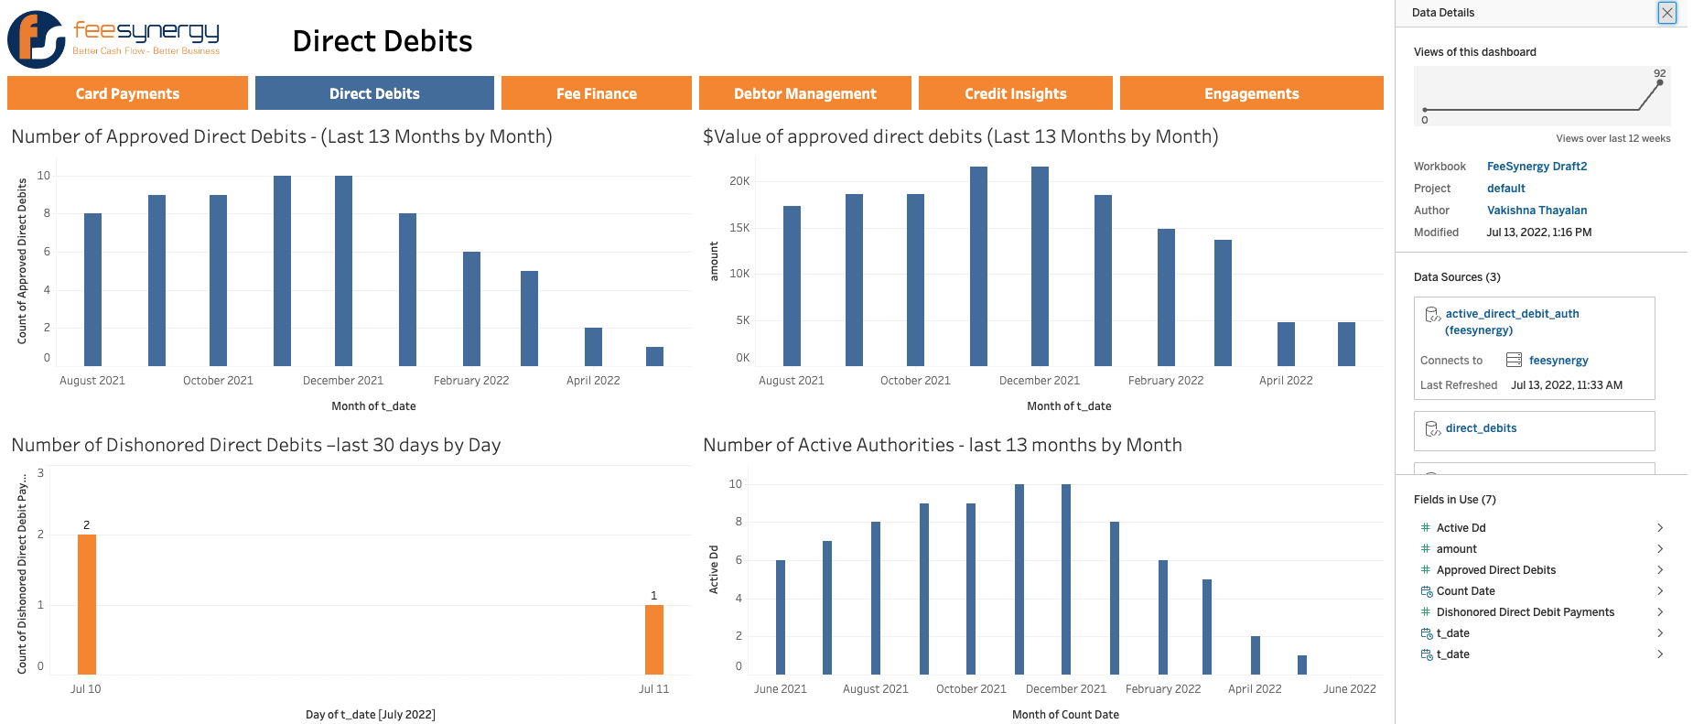
As a user I want to be able to see the data which makes up the visualizations so that I can verify the chart is accurate.

Slide 24
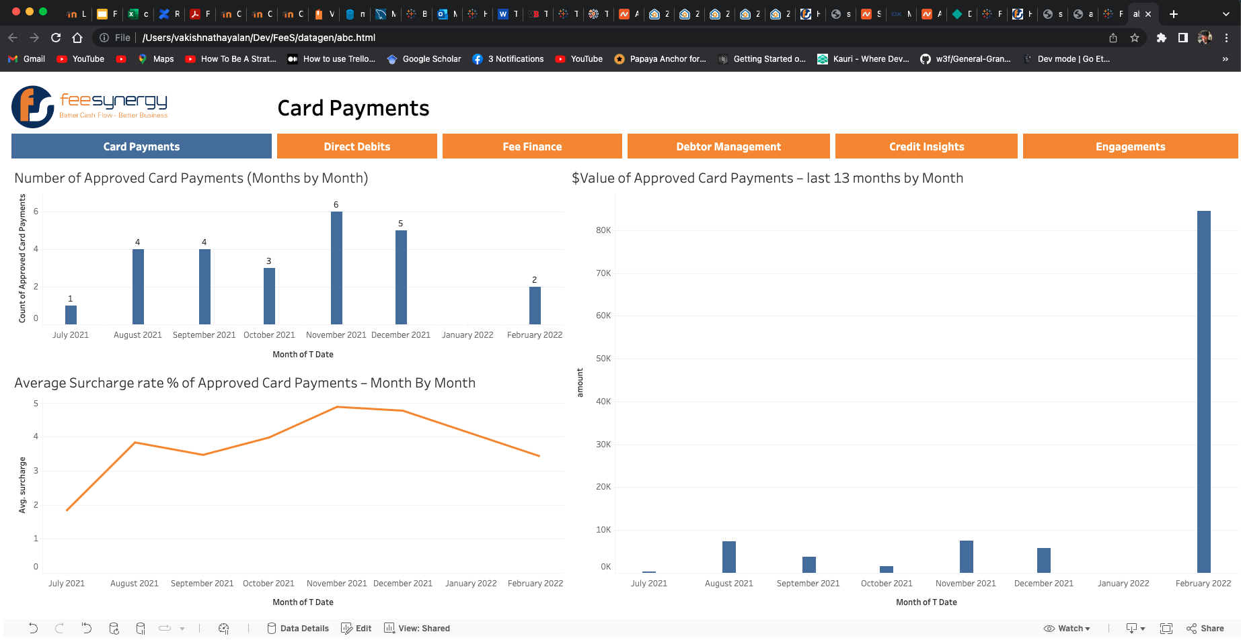
As a user I want to be able to access the visualizations on a web browser so that I use virtually any platform.

Slide 25
3.4:
Report Concept

Slide 26
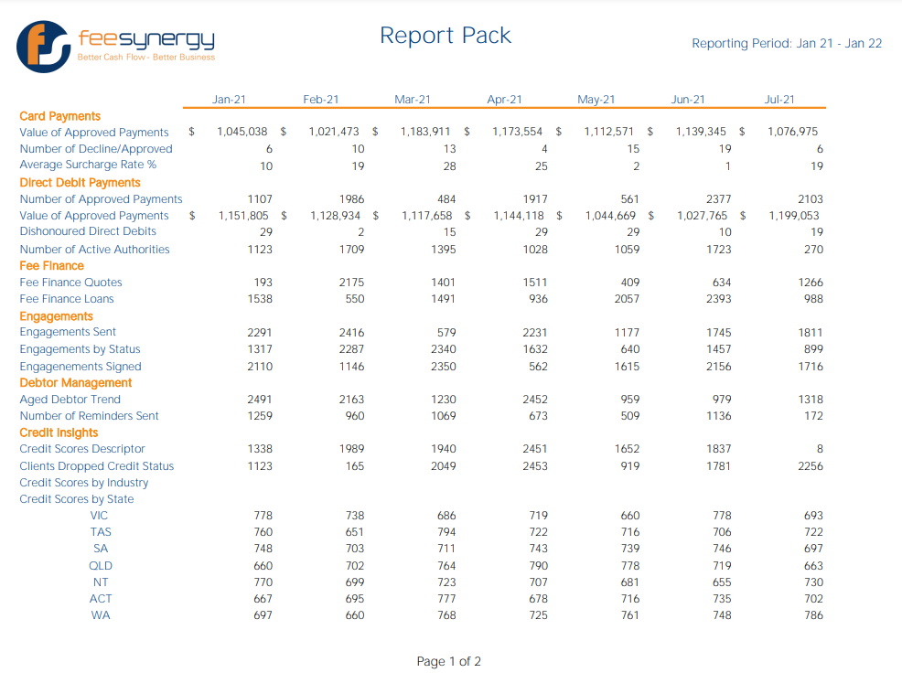
3.4
Report Concept
As a user I want the company logo and colour scheme so that it reflects the company’s brand
As a user I want the page number on the bottom so that I can keep the pages organised when printed out

Slide 27
3.4
As a user I want a heading for the report so that I can easily differentiate with other reports
Report Concept
As a user I want the reporting period displayed so that I know what period is included in the report.

Slide 28
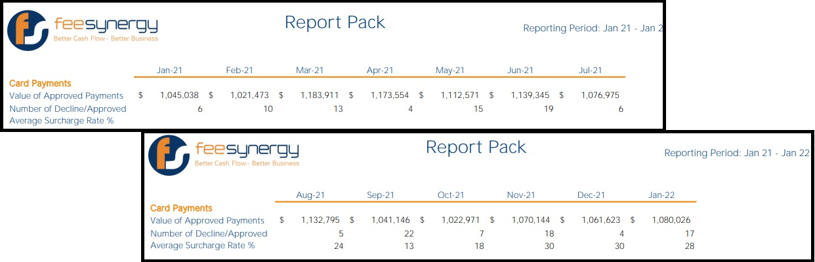
3.4
As a user I want the rolling 13 months displayed to compare the current month to the same month in the previous year
Report Concept
Page 1
Page 2
As a user I want the headings to repeat on each page so I can find information faster

Slide 29
4:
Screen Shared - Software Demo & Discussion
Please visit http://137.184.249.146 or http://178.128.85.207 to see a live prototype.

Slide 30
5.0:
Project Planning

Slide 31
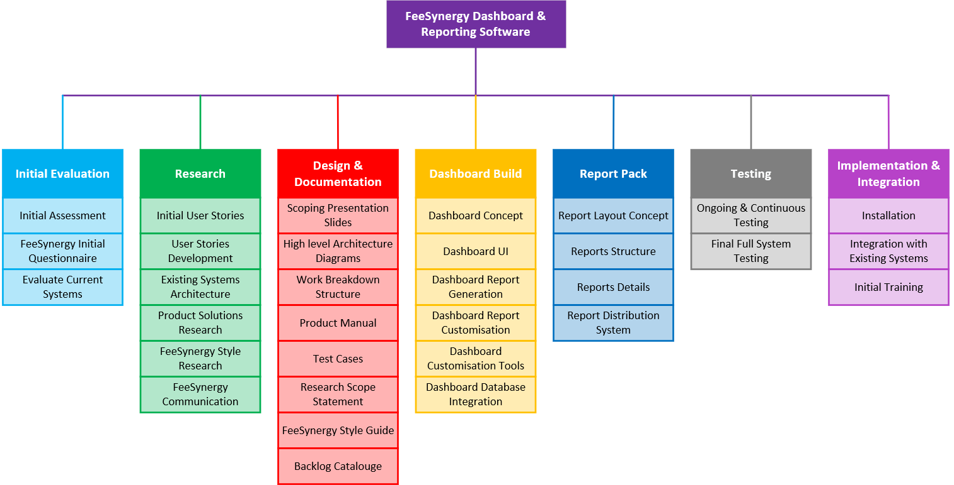
5.1
Work Breakdown Structure

Slide 32
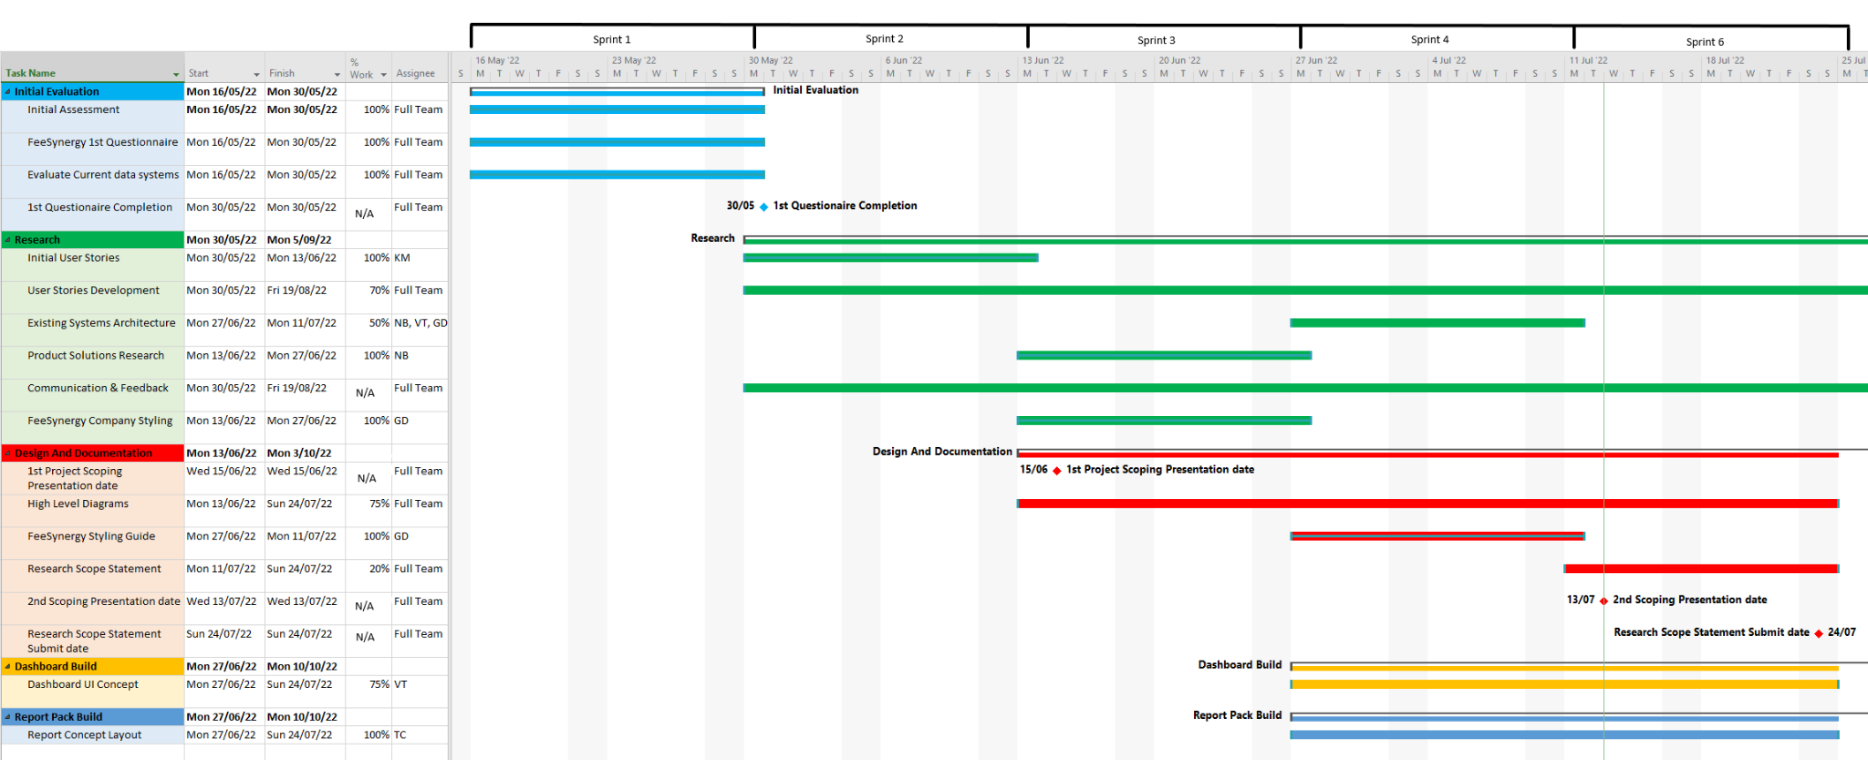
5.2
Gantt Chart

Slide 33
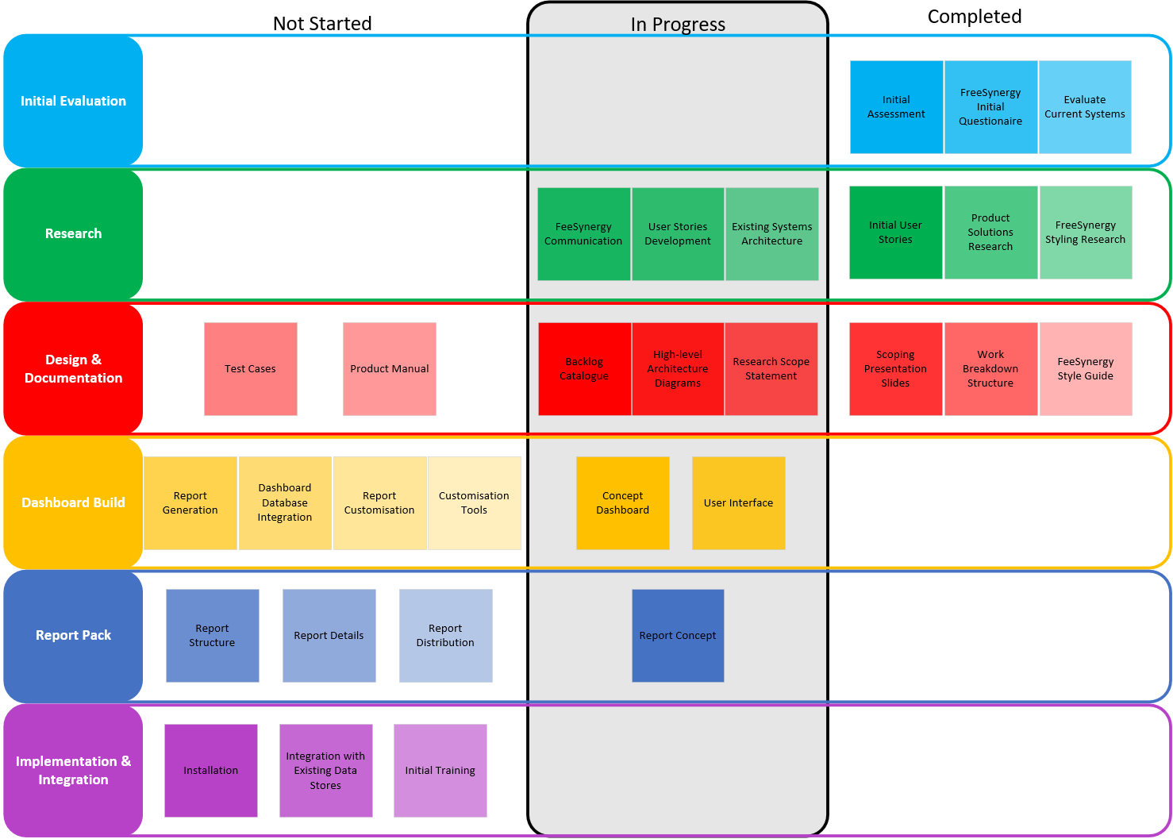
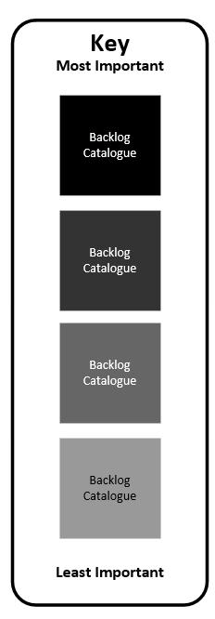
5.3
Backlog Catalogue
*Testing will be continuous throughout Dashboard Build Epic

Slide 34
6.0:
Project Maturity

Slide 35
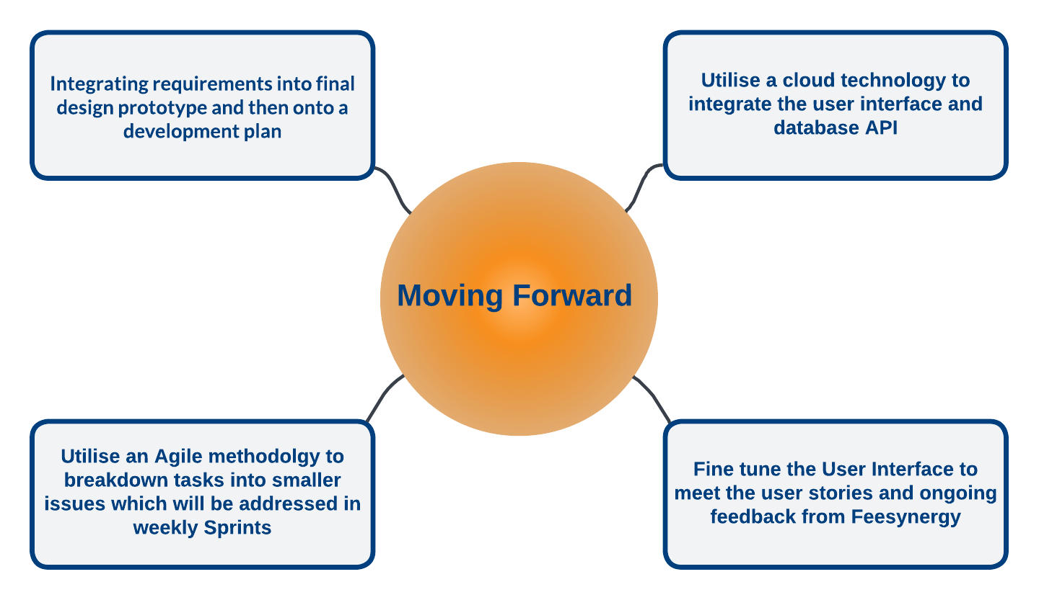
6.1
Project Progression
Moving forward into the next stages of the project we will be utilising these areas to stay on track.

Slide 36
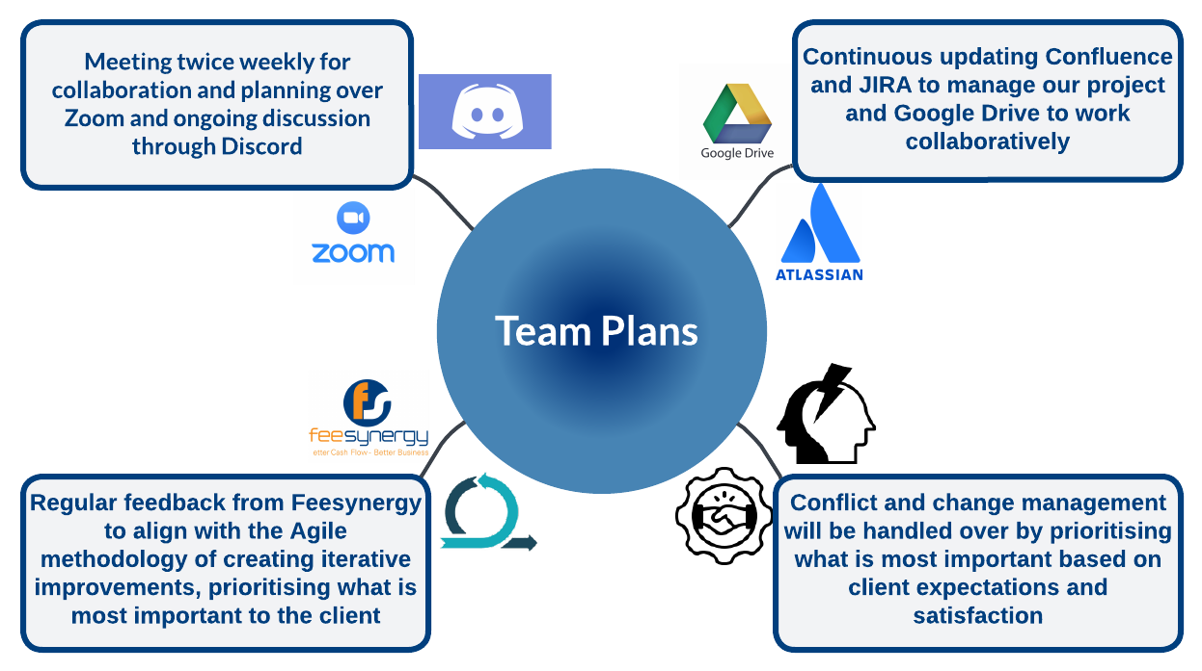
6.2
Project Progression
Ongoing plan on how the project team will continue to work to stay on track, ensuring the project is completed on time and to client expectations.

Slide 37
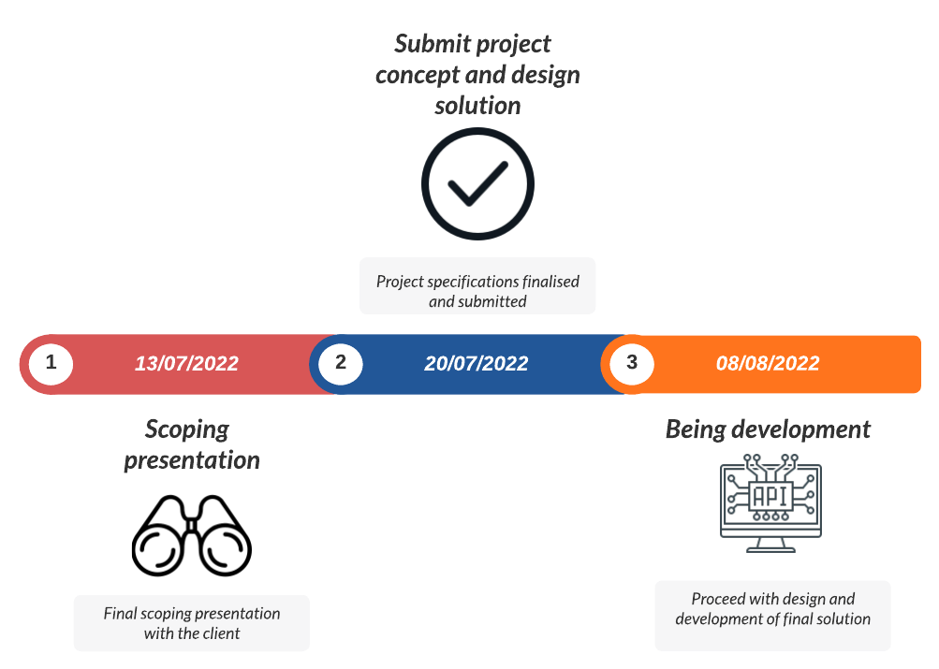
6.3
Project Progression
Projected timeline for continued project development

Slide 38
7.0:
Conclusion

Slide 39
7.1
What we have covered
Profile of the business and business problem.
The system overview and system models
Comparison of PowerBI, Amazon Quicksight and Tableau
Sample dashboards/graphs and sample reports
Our work breakdown structure, project planning and backlog
Our strategy for moving forward and managing the project
Our milestones, past, present and upcoming.
Conclusion

Slide 40
7.2:
Q & A / Feedback
Please address your Questions & Concerns / Feedback

